Slide 1
Stock Market Analysis Kajol Gupta

Slide 2
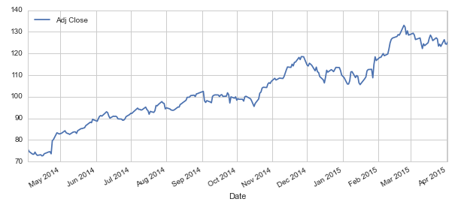
INTRODUCTION
In this portfolio project we will be looking at data from the stock market, particularly some technology stocks. We will learn how to use pandas to get stock information, visualize different aspects of it, and finally we will look at a few ways of analyzing the risk of a stock, based on its previous performance history. I will also be predicting future stock prices through a Monte Carlo method.

Slide 3
Statement of Problems
Here are the few questions which I will answer and show by the project Stock Market Analysis.
1.) What was the change in price of the stock over time?
2.) What was the daily return of the stock on average?
3.) What was the moving average of the various stocks?
4.) What was the correlation between different stocks' closing prices?
And what was the correlation between different stocks' daily returns?
5.) How much value do we put at risk by investing in a particular stock?
6.) How can we attempt to predict future stock behavior?

Slide 4
Existing System
Moneycontrol have been to chronicle the growth of the Indian economy. And along with it we have grown as well. Starting off as a financial portal that began by offering end-of-day stock prices to today arguably becoming India's biggest store of news (text and videos), analysis, data and tools on investing (across diverse asset classes), personal finance, the business sector and the economy.
Groww.in finds the best Mutual Funds to invest in select one of the ready-made baskets of funds or select your own.
By help of these we can see the stocks, the prices of various shares in market. But with my Portfolio Project I can analyse the different stocks, their relations with other companies and can analyse the risk and can calculate the risk. I can also predict future stock prices.

Slide 5
Problem Analysis

Slide 6
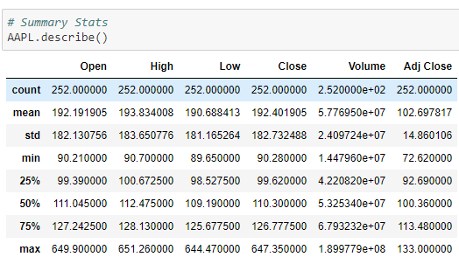
1.) what was the change in price of stock over time?

Slide 7
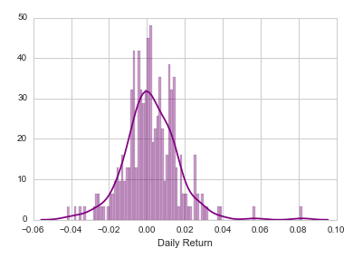
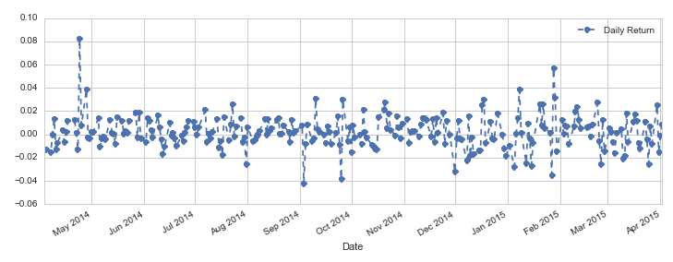
2.) What was the daily return of the stock on average?

Slide 8
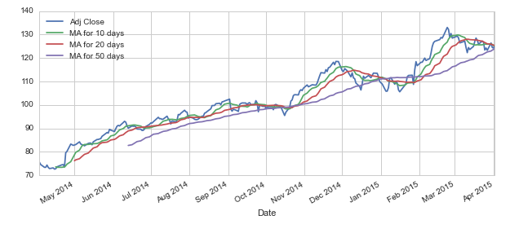
3.) What was the moving average of the various stocks?

Slide 9
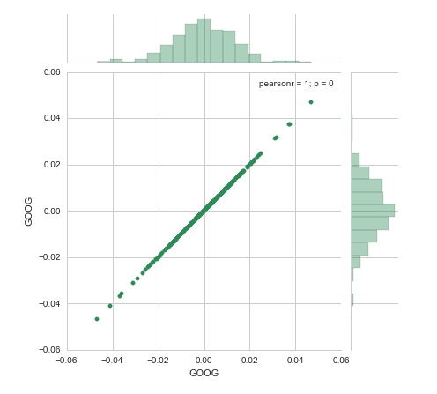
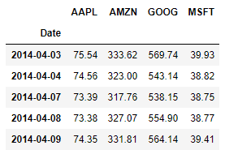
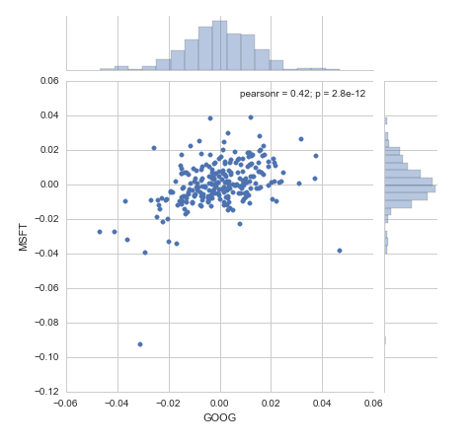
4.) What was the correlation between different stocks of closing prices and daily returns?

Slide 10
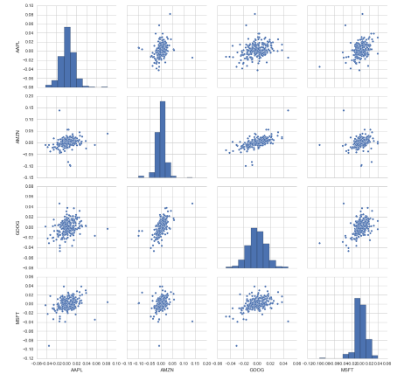
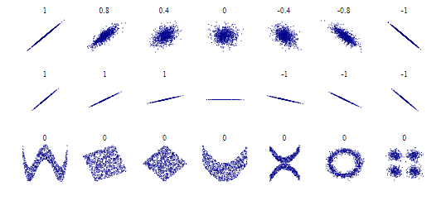

Slide 11
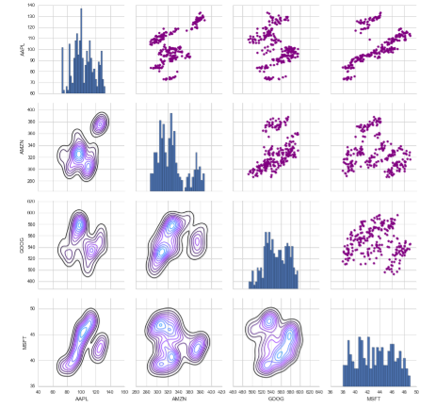
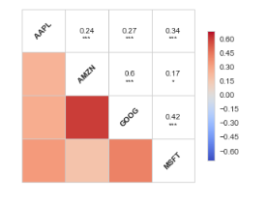

Slide 12
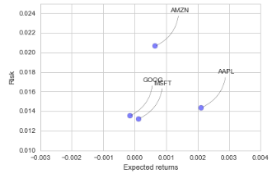
5.) How much value do we put at risk by investing in a particular stock?

Slide 13
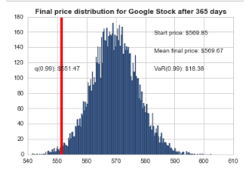
6.) How can we attempt to predict future stock behavior?

Slide 14
Thank You!

